Slide 1
AI POWERED EVENT MANAGEMENT
Team Name : Spam World
Presented by :
Devadharshini K S
Dharshini R
Gnanavarsha P
Keshini S

Slide 2
Contents
Introduction to AI Powered Event Planning System
Understanding User Requirements and Preferences
Core Features of the System
AI-Driven Recommendation Mechanism Explained
User Interface: Sign Up and Login Pages
Chatbot Integration for Enhanced User Experience
Tracking System for Efficient Event Management
AI Benefits

Slide 3
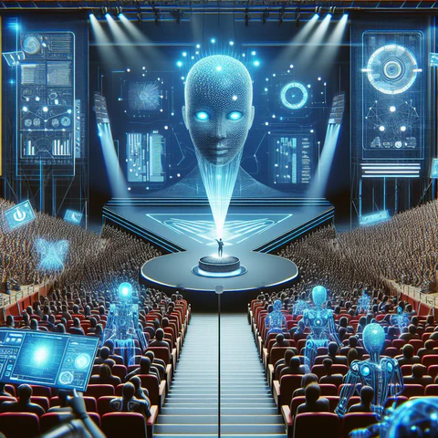
Introduction to AI Powered Event Planning System
The AI Powered Event Planning System introduces a transformative approach to organizing events.
Combining advanced artificial intelligence with innovative planning strategies, this system is designed to streamline the event management process.
By automating various tasks, it increases efficiency and enhances user satisfaction, ultimately leading to successful events. Let’s explore its functionalities and benefits.

Slide 4
Understanding User Requirements and Preferences
User Profiles
Creating detailed user profiles helps to understand individual preferences and requirements. By analyzing demographic data, previous event choices, and stated preferences, the system tailors its recommendations. For example, if a user frequently chooses outdoor venues, the system prioritizes similar options in future event planning.
Feedback Mechanisms
Incorporating feedback mechanisms enables continuous improvement of the planning process. Users can rate venues, suppliers, and services after their events, providing valuable insights. This feedback loop ensures that the system evolves according to user experiences, making it more effective over time.

Slide 5
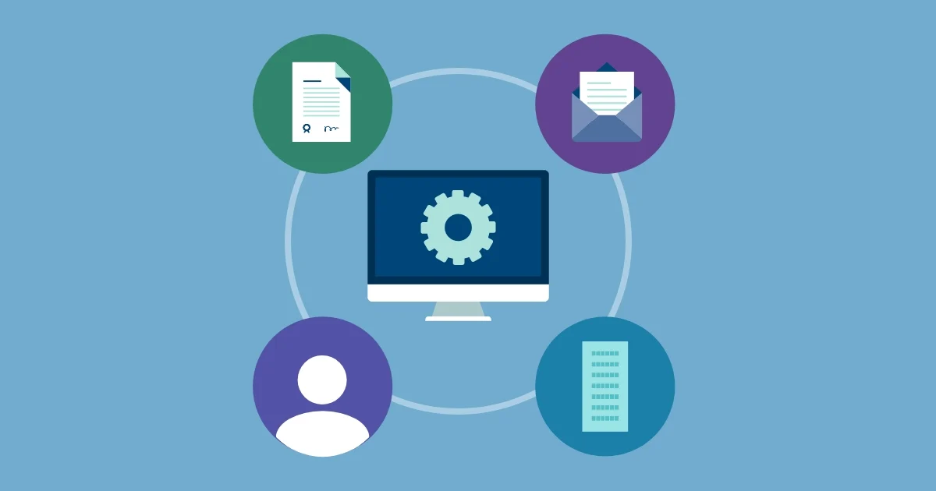
Core Features of the System
The AI Powered Event Planning System is equipped with several core features that enhance event management. Key functionalities include automated scheduling, budget tracking, venue selection assistance, and vendor relationship management. These tools not only save time but also reduce the stress typically associated with event planning. Furthermore, users can benefit from a centralized dashboard that provides a holistic view of all event elements.

Slide 6
FRONTEND
HTML : HTML (HyperText Markup Language) was used to structure the content on the web pages. It is the backbone of the webpage, defining the layout and organization of elements. Document Structure: Explanation of <!DOCTYPE html>, <html>, <head>, <body>.
<div>: To create divisions or sections on the page <header>: For the top section containing the logo and navigation. <footer>: For the bottom section containing copyright and contact information. <nav>: For the navigation menu. <section>: To organize content into different sections.

Slide 7
CSS :
Cascading Style Sheets, is a stylesheet language used to control the presentation of a webpage. It allows developers to separate the content of a webpage (written in HTML) from its design and layout Styling Overview:
CSS was used to define the visual presentation of HTML elements. It enabled us to create a consistent and visually appealing design across all web pages. Selectors and Properties:
We utilized various CSS selectors such as classes (.) and IDs (#) to target specific HTML elements and apply styles like: Colors:
color, background-color Typography:
font-family, font-size, font-weight Spacing:
margin, padding Borders:
border, border-radius

Slide 8
BACKEND
Development with Flask
Overview: Flask:
Flask is a lightweight and flexible web framework for Python. It is used to build the backend of the application, managing server-side operations, routing, and handling requests.
Key Features of Flask:
Simplicity and Flexibility
Routing
Template Engine
Request Handling
Extensions

Slide 9
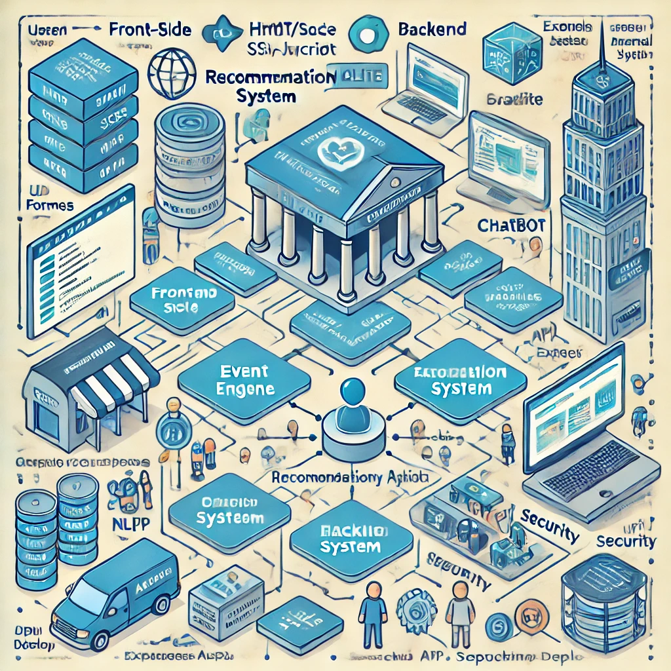
ARCHITECTURE
Frontend (Client-Side)
Backend (Server-Side)
External APIs
Recommendation System
Chatbot
Tracking System
Security
Deployment
Workflow

Slide 10
API KEY
Google AI Platform API :
The Google AI Platform API was leveraged to develop and deploy AI-driven features within the event management system, enabling advanced capabilities like prediction, recommendation, and natural language processing.
Applications in the System:
Recommendation Engine
Predictive Analytics
Natural Language Processing (NLP)
Feedback Analysis

Slide 11
AI-Driven Recommendation Mechanism Explained
Dynamic Suggestions
The system offers dynamic suggestions based on user behavior and trends. As users plan their events, real-time analytics refine the options further, ensuring that the suggestions remain relevant and appealing.
User Engagement
Enhanced user engagement is achieved by providing tailored suggestions. Users feel valued when the system recognizes their preferences, increasing satisfaction and likelihood of repeat usage.

Slide 12
User Interface: Sign Up and Login Pages
User-Friendly Design
The sign-up and login pages feature a clean, user-friendly design that facilitates ease of navigation. Users can quickly create accounts or access their profiles without unnecessary complexity, streamlining their experience right from the beginning.
Security Features
Robust security features ensure the safety of user data. The system employs SSL encryption and secure password protocols, giving users confidence that their personal information is protected during the sign-up and login processes.
Accessibility Options
Various accessibility options are integrated into the interface. This includes voice commands, text-to-speech functionality, and screen reader compatibility to cater to users with different needs and preferences, ensuring inclusivity.

Slide 13

Chatbot Integration for Enhanced User Experience
The integration of chatbots within the AI Powered Event Planning System enhances user experience significantly. These chatbots provide immediate assistance, answering common queries and guiding users through the event planning process. By utilizing natural language processing, the chatbots facilitate interactive conversations, ensuring that users receive timely and relevant information. They are available 24/7, offering a level of service that is convenient and supportive for users seeking assistance.

Slide 14
Tracking System for Efficient Event Management
Real-Time Tracking
The tracking system allows for real-time monitoring of all event elements. Users can view updates on budgets, vendor statuses, and guest lists live. This ensures that there are no surprises on the event day, leading to a smoother execution.
Resource Allocation
Effective resource allocation is made easy through the tracking system analytics. Users can optimize their budgets and ensure that resources are utilized efficiently, minimizing waste and maximizing impact on the event experience.

Slide 15
AI Benefits
Automated Planning
Quick Decision-Making
Customized User Experience
Budget Optimization
Reduced Human Error
Chatbot Integration
Interactive Features

Slide 16

THANK YOU

